Slide 1
Principles of Endocrinology
2011

Slide 2
at the end of discussion will understand about
The endocrine system
Term of autocrine, paracrine, endocrine
Hormones
Control of endocrine gland function
The receptor and their role
Signaling process
Metabolism of hormone
Relationship between hormone and other signaling molecules
Mechanism of endocrine diseases

Slide 3
Endocrine system
The specialty of endocrinology encompasses the study of glands and the hormones they produce
The term “endocrine” denotes internal secretion of biologically active substances
The endocrine systems release hormones into the circulation to convey information to target cells that contain cognate hormone receptors

Slide 4
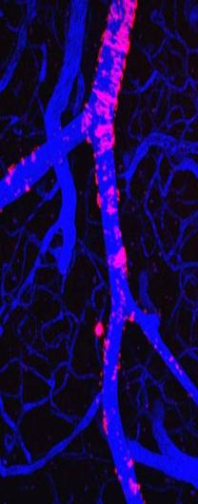
The endocrine system
Endocrine cells
Neurotransmitter cells
H
H
H
H
H
H
H
H
Autocrine
H
N
H
H
H
Axon
N
H
N
Paracrine
H
N
N
H
N
H
H
H
Hormone target cells
Neurotransmitter and hormone target cells

Slide 5
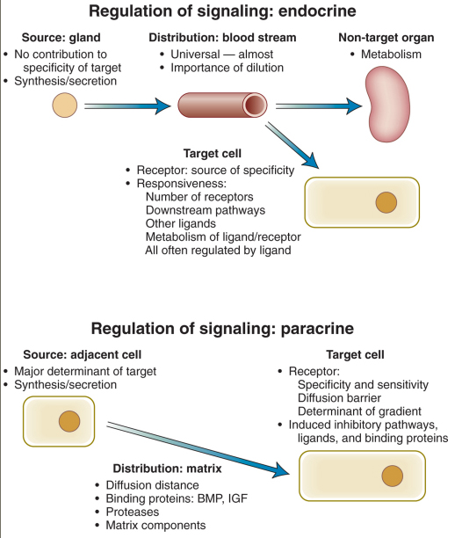
Comparison of determinants of endocrine and paracrine signaling

Slide 6
Endocrine organs
Endocrine organ and Hormone
Organs | Hormone
Classic endocrine gland
In the brain
- Hypothalamus | Releasing & inhibitory factors
- Anterior pituitary gland | ACTH, TSH, LH, PRL
- Posterior pituitary gland | Oxytocin, ADH
In the periphery
- Thyroid gland | T3 and T4
- Parathyroid gland | PTH
- Adrenal gland | corticosteroid, ephinephrine
- Ovarial and Testis | Sex`steroid
- Pancreas | Insulin, Glucagon, Somatostatin
Non traditional endocrine organs
- Kidney | Renin, Erythropoietin
- Adipose tissue | Leptin, Resistin, Adiponectin, etc
- Heart | Natriuretic peptide
Greenspan’s – Basic and Clinical Endocrinology, 2007

Slide 7
Hormones
Hormones can be defined as chemical signals secreted into the bloodstream that act on distant tissues, usually in a regulatory fashion
Transport in body fluids
An organic molecules produced by endocrine organs in response to specific stimuli that exert their action on specific target cells
A single hormone cab exert various effects in different tissues, or conversely, a single function can be regulated by several hormones
Porth CM. Pathophysiology – Concept of Altered Heath Status. Lippincott - 1994

Slide 8
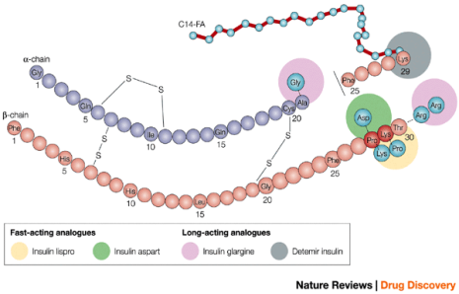
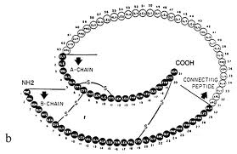
Insulin and IGF molecules

Slide 9
Others signaling molecules
Neurotransmitters
Are synthesized in the cell body of neuron and travel down the axon
Vitamins
Essential substances derived from the diet
Vitamins also act in ways that resembles hormones
Eicosanoid: prostaglandins & related compounds
Are derived from polyunsaturated fatty acid
The mechanism of action resemble those of hormones → surface and nuclear receptor
Metabolites
Derivatives of fatty acid, cholesterol, and bile acid can function as hormones when they are synthesized in the body
Oncogens

Slide 10
Five major classes of hormones
Amino acid derivates:
Dopamine, catecholamine, thyroid hormones
Small neuropeptides:
Gonadotropin-releasing hormone (GnRH)
Thyrotropin-releasing hormone (TRH)
Somatostatin, vasopresin
Large proteins:
Insulin, luteinizing hormone (LH), PTH produced by classic endocrine glands
Steroid hormones:
Cortisol, estrogen that are synthesized from cholesterol-based precursors
Vitamin derivates:
Retinoids (vit-A), vitamin-D

Slide 11
Hormone synthesis
Hormone are synthesized as required on a daily, hourly, or minute-to-minute basis with minimal storage, with some exceptions (thyroid gland, contains enough storage hormone to last for about 2 months)
The synthesis of hormone and their receptors occurs through a classic pathway of gene expression (transcription → mRNA → protein → posttranslational protein processing → intracellular sorting, membrane integration, or secretion)
The synthesis of hormone can also through conversion of hormone precursor

Slide 12
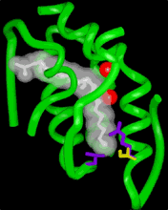
Precursor | Type of compound | Example of hormone
Protein | Protein | Growth hormone
Cleavage of peptide Cleavage of amino acid | Peptide Thyronine | ACTH Thyroxine
Cholesterol | Steroid | Cortisol
 | Steroid | 1,25OH-D
Amino Acids | Modified amino acid | Epinephrine
 | Tripeptide | TRH
Fatty acid | Retinoid | Retinoic acid
 | Eicosanoid | Prostaglanndin E1

Slide 13
Feedback mechanism
Feedback mechanism, both positive and negative is a fundamental feature of endocrine systems
Each of the major of hypothalamic-pituitary-hormone axes is governed by negative feedback, to maintain hormone levels within relatively narrow range
Positive feedback control also occurs but not well understood
→ the estrogen-mediated stimulation of the mid cycle LH surge. Though chronic low level of estrogen are inhibitory, when gradually increasing of estrogen levels stimulate LH secretion

Slide 14
The two major types of control of endocrine gland function
CNS Input
Other Input
Varied Input
Hypothalamus
Releasing hormone
Free-standing endocrine gland
Pituitary
Tropic hormone
Peripheral Gland
Hormone
Target
Target
Effect
Effect
Greenspan’s Basic & Clinical Endocrinology, 2007

Slide 15
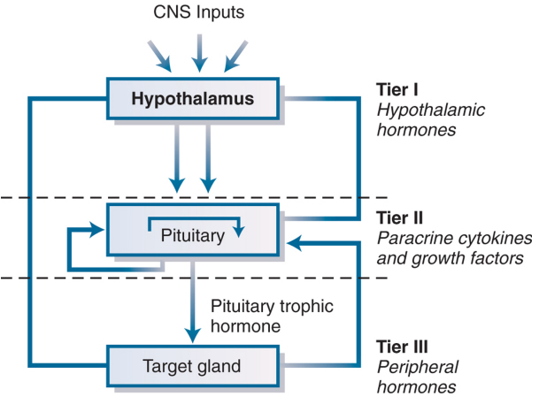
Model for regulation of anterior pituitary hormone secretion by three tiers of control

Slide 16
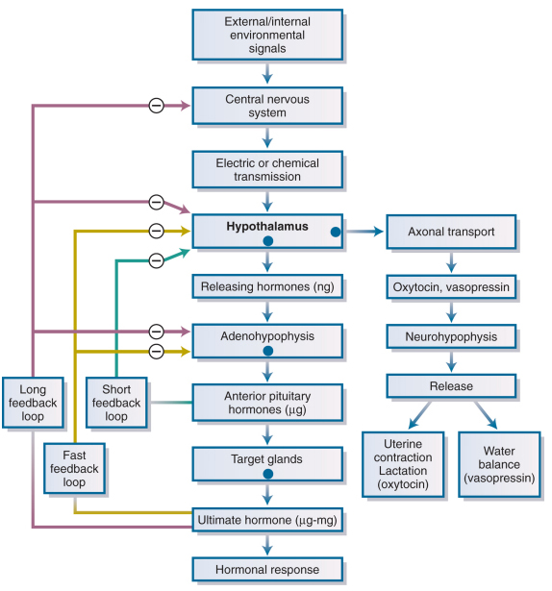
Peripheral feedback mechanism and a million-fold amplifying cascade of hormonal signals

Slide 17
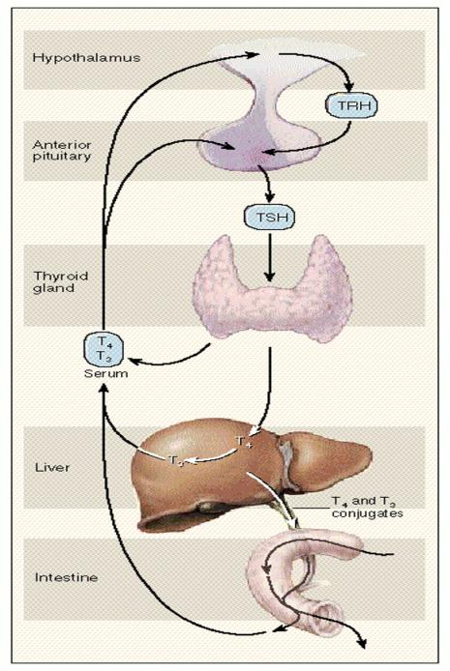
HYPOTHALAMUS-PITUITARY-THYROID & EXTRATHYROIDAL PATHWAY of THYROID HORMONE METABOLISM
Hypothalamus
TRH
Anterior pituitary
TSH
Thyroid gland
T4/T3 serum
T4
Liver
T3
T4 & T3 conjugated
iodine
Intestine
Intestine
Surk MI, 1995. NEJM;333(25):1688

Slide 18
Hormone secretion, transport and metabolism
Hormone secretion is induced by multiple specific biochemical and neural signals. Integration of these stimuli results in the net temporal and quantitative secretion
Hormone secretion also adheres to rhythmic patterns. Cicardian rhythms serve as adaptive responses to environmental signals and are controlled by cicardian timing mechanism
Circulating level of hormone is determined by its rate of secretion and its half life
Free form hormones (unbound to protein transport) is active form of hormones

Slide 19
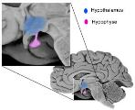
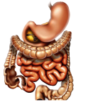
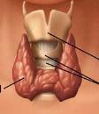
TSH
Iodide
T4 + T3
Albumin
Pre-albumin
TBG
Protein bound = inactive
Free form = active

Slide 20
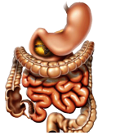
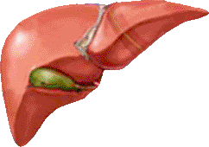
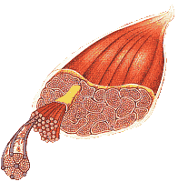
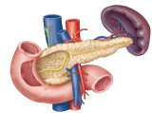
Major organ involved on glucose homeostasis
incretin
gluconeogenesis
lipolysis
Blood Glucose
glycogenesis
lipogenesis
adipocytes
Glucose uptake
β-cell: insulin
α-cell: glucagon
muscle
Pancreas

Slide 21
Target organs
Target organs mount a response to given hormone
They must express an appropriate cognate hormone receptor protein and molecules that mediate the receptor’s downstream effects intracellularly

Slide 22
The signal transduction pathways
Stimulus (hormones)
Activated effectors
Receptor
Effectors
1
G protein
Second massenger
Signal
Nuclear Receptor
Signal
Activated effectors
Effectors
2
Gerald Karp, 2003
Stimulus (ligand)
Activated effectors
Receptor (inactive)

Slide 23
types of cell-surface receptors
G protein-coupled receptors
Tyrosine kinases receptors
Integrin
other signaling pathway
Calcium ion
Nitric oxide

Slide 24
Membrane receptor signaling
G protein-coupled Seven transmembrane
Insulin/IGF-I Tyrosine kinase
Cytokine/GH/PRL
Growth factor Tyrosine kinase
Activin/MIS/BMP TGF-β Serine kinase
G Protein PKA, PKC
Membrane
JAK/STAT
Ras/Raf MAPK
Smads
Nucleus
Target gene

Slide 25
Membrane Receptor Families and Signaling Pathways
Receptors | Effectors | Signaling Pathway
G protein-coupled seven-transmembrane (GPCR)
- β-adrenergic | Gsα, adenylate cyclase | Stimulation of cyclic AMP production Protein kinase A Calmodulin, Ca⁺⁺-dependent kinases
- LH, FSH, TSH | Ca⁺⁺ channels
- Glucagon
- ACTH, MSH, GHRH, CRH
- α-adrenergic | Giα | Inhibiton of cyclic AMP production
- Somatostatin |  | Activation of K⁺, Ca⁺⁺ channels
- TRH, GnRH | Gq, G11 | Phospholipase C, diacylglycerol, IP3, PKC, VDCC
Receptor tyrosine kinases
- Insulin, IGF-1 | Tyrosine kinases, IRS-1 to 4 | MAP kinases, PI3kinase, RSK
- EGF, NGF | Tyrosine kinases, ras | Raf, MAP kinases, RSK
Cytokine receptor-linked kinase
- GH, PRL | JAK, tyrosine kinases | STAT, MAP kinase, PI3 kinase, IRS-1, IRS-2
Serine Kinase
- Activin, TGF-β, MIS | Serine kinase | Smads
IP3 = inositol triphosphate, IRS = insulin receptor substrate, MAP = mitogen-activated protein, MSH = melanocyte-stimulating hoemone, NGF = nerve growth factor, PI = phosphatylinositol, RSK = ribosomal S6 kinase, TGF = transforming growth factor, VDCC = voltage-dependent Ca channels

Slide 26
SITE ACTION of TSH
Thyroid gland
TSH
I⁻
Adenyl cyclase inactive
Phospholypase inactive
G protein
NIS
active
Cell membrane
active
Activation
expression
cAMP
Cell hyperthrophy
Expression TPO & Thyroglobuline
Cytoplasm
I⁻
DIT MIT
follicle
T3 T4
Thyroid hormones secretion

Slide 27
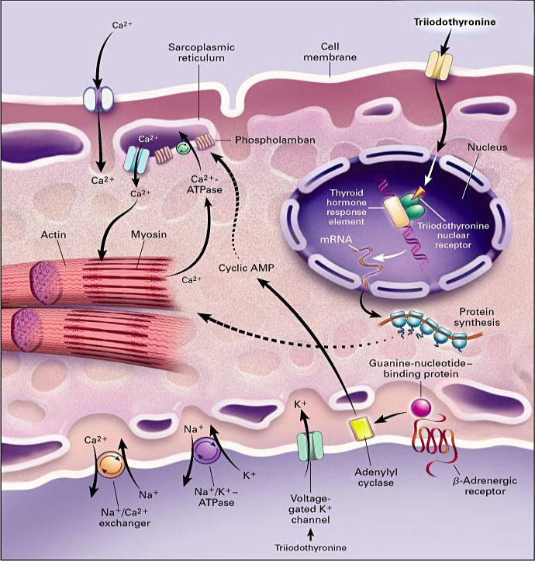
Thyroxin (T4)
(T3)
Site action of triiodothyronin on cardiac myocites
T3
Klein I, 2001 NEJM;344:501

Slide 28
Insulin & glucose transporter protein-4 (Glut-4)
insulin
glucose
FFA
IR
1
IRS-1 serine phosphorylation
IRS-1 tyrosin phosphorylation
translocation
p110
p85
PI3K
Glut 4
Akt
aPKC
p70 -rsk
PP-1
GSK3
glucose metabolism
glycogen/lipid/protein synthesis
specific gene expression
Buse JB, 2003; Boden G, Diabetes Care 27, 2004

Slide 29
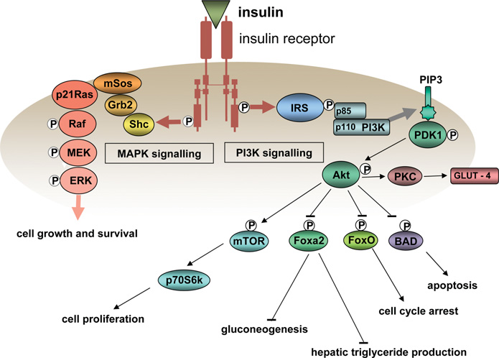
Principal signalling pathways activated by the insulin receptor
IGF
IGF receptor

Slide 30
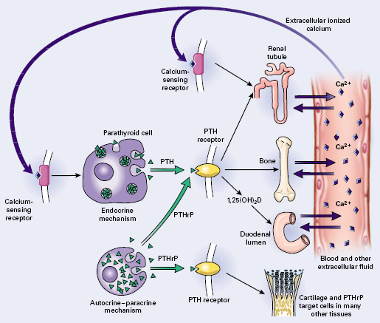
The Parathyroid Axis (cross talk at receptor)
N Engl J Med 2000;343:1863-1874

Slide 31
Examples of convergence, divergence, and crosstalk among various signal-transduction pathways
G protein-linked receptors
Acetylcholine, histamine
NA, 5-HT, ATP, PAF, TXA₂,
Glutamate, Angiotensin II,
Vasopressin, Bradykinin,
Substance P, Bombesin,
Neuropeptide Y, Thrombin, Cholecystokinin, Endothelin,
Neuromedin, TRH, GnRH, PTH
Odorants, Light
R
III
II
I
G
PLCβ
IP₃
IP₃R
Ca²⁺
PIP₂
Tyrosine kinase-linked receptors
PLCγ
DAG
PKC
P
Cellular activity & mitogenesis
PDGF, EGF, etc.
PI3K
PIP₃
P
GAP
Ras
Raf
MAP kinase
Gerald Karp, 2003

Slide 32
Hormone actions
Hormones Action | Hormones Action
GH | Fetal development
GH, IGF-1, IGF-2, FGF, PDGF, tyroxin | Cell growth & cancer
Insulin, Glucagon, Somatostatin, Cathecolamine, Glucocorticoid. | Intermediary metabolism
Vasopresin, ANP, PTH, Ang-II | Mineral & Water metabolism
RAA, NAP, Vasopresin | Cardiovascular & Renal function
PTH, vit-D, IGF-1 | Skeletal function
Gonadotropin, Progresteron, Estrogen | Reproductive function
Glucocorticoid, Estrogen | Immune system
Endocrine & Nervous systems interactin multiple ways. Hormones regulate behavioral cognitive function | Central Nervous System (CNS)
Greenspan’s – basic and Clinical Endocrinology, 2007

Slide 33
Hormone metabolism
Hormone
Hormone
Precursor
Precursor
2nd Hormone
Degraded Hormone
2nd Precursor
Actions
Actions
2nd Precursor
Degraded Hormone
Elimination
Degraded Hormone
Further Degraded Hormone
2nd Precursor
2nd hormone
2nd Hormone
Actions

Slide 34
Relationship between hormones and other signaling molecules

Slide 35
Neurotransmitters and Hormones
Cellular genes
Proteins or Peptides
Regulatory proteins
Enzymes
Amino acid analogs
Neurotransmitters
Steroids
Fatty acids
Hormones
Eicosanoids
Oncogenes
Oncogene products
Paracrine and
Autocrine factors
Diet
Vitamines

Slide 36
Interrelations between the endocrine and immune system
Immune modulators
±
Immune System
Classic hormone
Endocrine System
±
±
Autoimmune disease
Abnormal Autoimmune Response
±
Greenspan’s Basic & Clinical Endocrinology, 2007

Slide 37
Mechanism of endocrine disease
Hormone excess
Hormone deficiency
Hormone resistance

Slide 38
Causes of Endocrine Dysfunction
Hyperfunction
Neoplastic
- Benign | Pituitary Adenoma (hyperparathyroidism, autonomous thyroid/adrenal nodules, pheocromocytoma)
- Malignant | Adrenal cancer, medullary thyroid cancer, carcinoid
- Ectopic | Ectopic ACTH, SIADH secretion
- Multiple Endocrine Neoplasia | MEN-1, MEN-2
Autoimmune | Graves’s disease
Iatrogenic | Cushing’s syndrome, hypoglycemia
Infectious / inflammatory | Subacute thyroiditis
Activating receptor mutations | LH, TSH, Ca⁺⁺ and PTH receptors G, α
Hypofunction
Autoimmune | Hashinoto’s thyroiditis, Type-1 DM, Addison’s disease
Iatrogenic | Radiation-induced hypopitutarism, surgical-hypothyroidism
Infectious / inflammatory | Adrenal insufficiency, hypothalamic sarcoidosis
Hormone mutation | GH, LH-, FSH-, vasopresin
Development defect | Turner’s syndrome, transcription factor
Nutritional / vitamin deficiency | Vitamin D deficiency, IDD
Hemorhagic / infarction | Sheehan’s syndrome, adrenal insuffiency
Hormone Resistance
Receptor mutations | Membrane-R (GH, vasopresin, LH,etc). Nuclear-R (AR, TR, ER, GR, etc)
Signaling pathway mutations | Albright’s hereditary osteodyctrophy
Postreceptor | Type-2 DM. leptin

Slide 39
Interfaces endocrinology with physiological system
Most glands are relatively inaccesible, the examination focuses on manifestation of hormone excess or deficiency
No standard endocrine history and examination
It is important to evaluate in the context of presenting symptoms, review of systems, family, social history, and history of medication that may influence to the endocrine systems
Physical examination involved evaluation all systems
Clinical judgment based on knowledge of disease prevalence and pathophysilogy
Laboratory testing plays an essential role by allowing the dynamics and quantitative assessment of hormone level
Imaging test are also used for diagnosis of endocrine disorders

