Slide 1
Complication
of
Diabetes Mellitus
Laksmi Sasiarini
2011

Slide 2
Acute Complication
of
Diabetes Mellitus

Slide 3
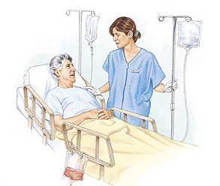
Hyperglycemic Crisis
Diabetic Ketoacidosis (DKA)
Hyperosmolar hyperglycemic state (HHS)
Hypoglycemia

Slide 4
KRISIS HIPERGLIKEMIA

Slide 5
Epidemiology
Diabetic Ketoacidosis
Mortality rates :
< 1% (adult subjects)
> 5 % (elderly and in pts with concomitant life- threatening illnesses)
Hyperosmolar Hyperglycemic State
Mortality rate 5-20 %
The prognosis of both conditions : extremes of age in the presence of coma, hypotension, and severe comorbidities

Slide 6
PRECIPITATING FACTORS
Infection (20% - 40%) → urinary tract and lung
CVA
Myocardial infarction
Pancreatitis
Discontinuation of or inadequate insulin therapy
Drugs (steroids, sympathomimetics, thiazides)

Slide 7
PATHOGENESIS

Slide 9
History and Physical examination
History of polyuria, polydipsia, weight loss, dehydration, weakness, and mental status change.
Physical findings : poor skin turgor, kussmaul respiration (DKA), tachycardia, and hypotension, mental status change (full alertness to profound lethargy or coma).
Focal neurologic signs and seizures → HHS
Nausea, vomiting, diffuse abdominal pain are frequent in pts with DKS (>50%).

Slide 10
Laboratory findings
plasma glucose, serum and urine ketones, electrolytes (with calculated anion gap), osmolality, arterial blood gases
blood urea nitrogen/creatinine
urinalysis
complete blood count with differential
electrocardiogram
bacterial cultures of urine, blood, and throat, etc
chest X-Ray

Slide 11
Diagnostic criteria for DKA and HHS
 | DKA |  |  | HHS
 | Mild | Moderate | Severe
Plasma glucose (mg/dl) Arterial pH Serum bicarbonate (mEq/l) Urine ketones Serum keton Effective serum osmolality (mosm/kg) Anion gap Alteration in sensoria and mental | > 250 7.25–7.30 15–18 (+) (+) Variable > 10 Alert | > 250 7.00–7.24 10 to 15 (+) (+) Variable > 12 Alert/drowsy | > 250 < 7.00 < 10 (+) (+) Variable >12 Stupor/coma | > 600 > 7.30 > 18 Small Small >320 Variable Stupor/coma
Anion gap : (Na+) - (Cl⁻ + HCO3⁻) (mEq/l).

Slide 12
Differential diagnosis
lactic acidosis
ingestion of drugs (salicylate, methanol, ethylene glycol, and paraldehyde)
chronic renal failure

Slide 13
Protocol for the management of adult patients with HHS
Diagnostic criteria:
blood glucose >600 mg/dl
arterial pH >7.3
bicarbonate >15 mEq/l
mild ketonuria or ketonemia
effective serum osmolality >320 mOsm/kg H2O
Na should be corrected for hyperglycemia (for each 100 mg/dl glucose >100 mg/dl, add 1.6 mEq to sodium value for corrected serum value)

Slide 14
TREATMENT
IV fluid (NS)
( initial : 1 l/hour; 15–20 ml · kg-1 BW · h-1)
Insulin (Continuous IV drip/im)
K+ (Potssium)
Bicarbonate (pH < 7) → in pts with DKA
PRECIPITATING FACTOR(S)

Slide 15
IV Fluids
Hydration Status ?
Severe hypovolemia
Mild dehydration
Cardioogenic shock
0.9% NaCl (1 L/h)
Hemodynamic monitoring
Evaluate corrected serum Na+
Serum Na high
Serum Na normal
Serum Na low
0.45% NaCl (250 – 500 ml/h) depending on hydration state
0.9% NaCl (250 – 500 ml/h) depending on hydration state
When serum glucose reaches 200 mg% (DKA) or 300 mg/dl (HHS), change to 5% dextrose with 0.45% NaCl at 150-250 ml/hr

Slide 16
INSULIN
Insulin Regular 0.14 u/kg/hr as IV continuos insulin infusion
Insulin Regular 0.1 u/kg/bolus/iv
RI 0.1 u/kg/h/iv infusion
If serum glucose does not fall by at least 10% in first hour, give 0.14 U/kg as IV bolus, then continue previous Rx
When serum glucose reaches 200 mg/dl, reduce RI infusion to 0.02-0.05 U/kg/hr IV, or give rapid acting insulin at 0.1 U/kg SC every 2 hrs. Keep serum glucose between 150 and 200 mg/dl until resolution of DKA
When serum glucose reaches 300 mg/dl, reduce RI infusion to 0.02-0.05 U/kg/hr IV. Keep serum glucose between 200 and 300 mg/dl until px is mentally alert

Slide 17
POTASSIUM
Initial serum K⁺< 3.3 mEq/L
Initial serum K⁺ ≥ 5.0 mEq/L
Initial serum K+ 3.3 – 5.5 mEq/L
Hold insulin and give 20-30 mEq K⁺/h until K+ > 3.3 mEq/L
Do not give K+ and check K+ every 2 h
Give 20 – 30 mEq K⁺ in each liter of iv fluid (2/3 as KCL and 1/3 as KPO4) to keep serum K+ at 4 – 5 mEq/LmEq

Slide 18
BICARBONATE
pH < 6.9
pH ≥ 6.9
NaHCO₃ (100 mmol/L) dilute in 400 ml H₂O + 20 mEq KCl, infuse for 2 hours
No NaHCO₃
Repeat every 2 h until pH ≥ 7.0 Monitor serum K⁺ every 2 hrs.

Slide 19
MAINTENANCE
Keep the serum glucose 150 – 200 mg% until metabolic control is achieved
Check electrolyte, BUN, venous pH, creatinine and glucose every 2 – 4 hours until stable
After resolution of DKA or HHS and when patient is able to eat, initiate SC multidose insulin regimen.
To transfer from IV to SC, continue IV indulin infusion for 1-2 hr after SC insulin begun to ensure adequate plasma insulin levels.
In insulin naïve pts, start at 0.5 U/kg to 0.8 U/kg body weight per day and adjust insulin as needed.
Continue to look for precipitating factor(s).

Slide 20
HYPOGLYCEMIA AND DIABETES

Slide 21
Definition
The ADA Workgroup on Hypoglycemia defined hypoglycemia in diabetes as “all episodes of abnormally low plasma glucose concentration that expose the individual to potential harm ”.
The cutoff glucose concentration for defining hypoglycemia is controversial.

Slide 22
The ADA Workgroup recommended that people with insulin secretagogue or insulin treated diabetes become concerned about the possibility of developing hypoglycemia at a self-monitored (or device estimated) plasma glucose concentration of ≤ 70 mg/dL (≤ 3.9 mmol/L).

Slide 23
ADA classification of hypoglycemia in diabetes
Severe hypoglycemia | An event requiring assistance of another person to actively administer carbohydrate, glucagon or other resuscitation actions. Plasma glucose measurements may not be available during such an event, but neurological recovery attributable to the restoration of plasma glucose to normal is considered sufficient evidence that the event was induced by a low plasma glucose concentration.
Documented severe hypoglycemia | An event during which typical symptoms of hypoglycemia are accompanied by a measured plasma glucose concentration ≤ 70 mg/dL (≤ 3.9 mmol/L).
Asymptomatic hypoglycemia | An event not accompanied by typical symptoms of hypoglycemia but with a measured plasma glucose concentration ≤ 70 mg/dL (≤ 3.9 mmol/L).
Probable symptomatic hypoglycemia | An event during which symptoms typical of hypoglycemia are not accompanied by a plasma glucose determination but that was presumably caused by a plasma glucose concentration ≤ 70 mg/dL (≤ 3.9 mmol/L).
Relative hypoglycemia | An event during which the person with diabetes reports any of the typical symptoms of hypoglycemia and interprets those as indicative of hypoglycemia with a measured plasma glucose concentration >70 mg/dL (>3.9 mmol/L) but approaching that level.

Slide 24
Risks of severe hypoglycaemia associated with different diabetes treatment
50
40
30
20
10
0
Patients affected per year (%)
Sulphonylurea- treated type 2 diabetes
Insulin- treated type 2 diabetes
“Standard” insulin therapy in type 1 diabetes
Intensively
Treated in type 1 diabetes (DCCT)

Slide 25
DiAGNOSiS ??

Slide 26
Whipple’s Triad
HYPOGLYCEMIA
Signs & Symptoms of HYpoglycemia
Resolution of Symptoms once Glucose Levels Rises
HYPOGLYCEMIA
Low Plasma Glucose Levels

Slide 28
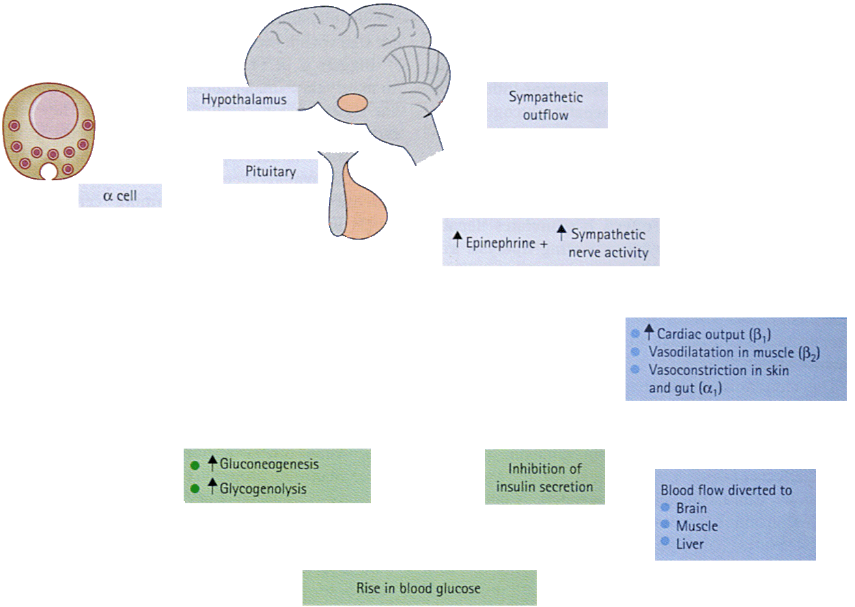
Principal metabolic effects of counter-regulation in response to acute hypoglycaemia
Hypoglycaemia
+
+
↑ACTH
↑Glucagon
↑Vasopressin
↑Growth hormone
↑Cortisol
+

Slide 29
The signs and symptoms of hypoglycemia can be divided into two categories :
Autonomic
Neuroglycopenic

Slide 30
AUTONOMIC
When the blood glucose levels drop significantly, the body releases epinephrine → this triggers certain processes like releasing the glucose stored in the liver (glycogen) in an attempt to stabilize the blood glucose levels.
Epinephrine also affects the nervous system and results in these characteristic signs and symptoms :
Anxiety
Dizziness
Hunger
Palpitations
Sweating
Trembling

Slide 31
NEUROGLYCOPENIC
As the blood glucose levels continue to drop without any intervention, the glucose supply to the brain is severely impaired and may result in the symptoms listed below.
Blurred vision
Confusion
Difficulty concentrating
Drowsiness
Irritability, anger
Poor coordination
Speech difficulty

Slide 32
Common Symptoms of Acute Hypoglycaemia in Diabetes
Autonomic | Neuroglycopenic | Malaise
Sweating Pounding heart Tremor Hunger | Confusion Drawsiness Speech difficulty Incoordination Atypical behaviour Visual disturbance Circumoral paraesthesia | Nausea Headache
Heller SR. Textbook of Diabetes 1, 2003, p.33.1

Slide 33
100
50
0
Relationships between the duration of diabetes
Altered symtoms of hypoglycaemia
(a)
100
50
0
Sweating and/or tremor
Patients affected (%)
(b)
100
50
0
Severe hypoglycaemia without warning
(c)
0-9
10-19
20-29
30-39
> 40
Duration of diabetes (years)

Slide 34
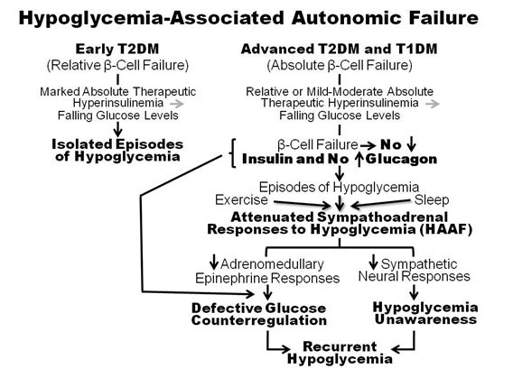

Slide 35
Factors that Precipitate or Predispose to Hypoglycaemia : Excessive insulin level
Excessive dosage | Error by patient, doctor or pharmacist
Increased insulin bioavailability | Accelerated absorbtion (exercise, injection into abdomen, change to human insulin) Insulin antibodies, Renal failure, Honeymoon periode
Increased insulin sensitivity | Counter-regulatory hormon deficiencies (Addison, Hypopituitarism) Weight loss, physical exercise, postpartum, menstrual cycle variation
Inadequate carbohydrate response | Missed, small or delayed meals Anorexia nervosa, Vomiting (gastroparesis), breast feeding, failure to cover exercise
Other factors | Exercise, alcohol, drugs
Heller SR. Textbook of Diabetes 1, 2003, p.33.1

Slide 36
Treatment of Hypoglycaemia
Established diagnosis
Capillary blood sample
Oral glucose (liquid) 120 cc
Evaluation
Intramuscular glucagon
0.5 – 1 mg repeat after 10 ‘
Maintainance 180 – 200 mg% 10% Dextrose Dextamethasone
Intravenous glucose
20 – 30 ml 50% dextrose

Slide 37
Komplikasi Kronik
Makroangiopati
Pembuluh darah jantung
Pembuluh darah otak
Peripheral vascular disease
Mikroangiopati
Retinopati diabetik
Nefropati diabetik
Neuropati (perifer)

Slide 38
United Nations (2006) :
Diabetes is a global pandemic posing a serious threat to global health, acknowledging it to be a chronic, debilitating, and costly disease associated with major complications.
The greater benefits (clinical and economical) → simultaneous control of glycemia, BP, and lipid levels

Slide 39
The implementation of the standards of care for diabetes has been supoptimal in most clinical settings.
A recent report (Cheung et al, 2009) indicated that only 57.1% of adults with diabetes achieved an A1C of 7%, 45.5% had a blood pressure 130/80 mmHg, 46.5% had a total cholesterol 200 mg/dl.
Only 12.2% of people with diabetes achieved all three treatment goals.

Slide 40
The American Diabetes Association’s Standards of Medical Care in Diabetes

Slide 41
Summary of glycemic recommendation for non-pregnant adults with diabetes 2010
A1C | < 7.0% *
Preprandial capillary plasma glucose | 70-130 mg/dl
Peak postprandial capillary plasma glucose | < 180 mg/dl
Key concepts in setting glycemic goals : A1C is the primary target for glycemic control Goals should be individualized based on : - duration of diabetes - age/life expectancy - comorbid condition - known CVD or advanced microvascular complications - hypoglycemia unawareness - individual patient considerations More or less stringent glycemic goals may be appropriate for individual patients
Postprandial glucose may be targeted if A1C goals are not met despite reaching preprandial glucose goals
*Referenced to a nondiabetic range of 4.0-6.0% using a DCCT-based assay.

Slide 42
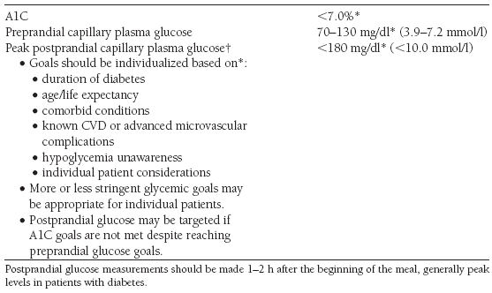
Summary of glycemic recommendation for non-pregnant adults with diabetes 2011

Slide 43
Blood Pressure Goal for Patients with Diabetes and Hypertension
The American Diabetes Association’s Standards of Medical Care in Diabetes
Patients with diabetes should be treated to a blood pressure < 130/80 mmHg.
In pregnant patients with diabetes and chronic hypertension, blood pressure target goals are 110-129 mmHg systolic and 65-79 mmHg diastolic.
Blood pressure should be measured at every routine diabetes visit
Measurement of BPin the office should be done by a trained individual and
should follow the guidelines stablished for nondiabetic individuals.

Slide 44
Tight BP Control vs. Tight Glucose Control
0 -
Stroke
End Point
DM Death
Complications
-10 -
-20 -
Reduction in Risk (%)
-30 -
Tight Glucose Control
-40 -
Tight BP Control
*P < 0.05
-50 -
UKPDS. BMJ. 1998:317;703-712.
Notes:
The UKPDS blood-pressure trial demonstrated the benefits of more intensive blood pressure control in individuals with type 2 diabetes. Those persons randomized to tight blood pressure control (mean treated blood pressure 144/82 mmHg) with an angiotensin-converting enzyme (ACE) inhibitor or beta-blocker had a 24% relative risk reduction in diabetes-related end points, 32% fewer diabetes-related deaths, and 44% fewer strokes compared with those in the less-tight control arm (mean treated blood pressure 157/87 mmHg).^{[27]}

Slide 45
Treatment strategies
The American Diabetes Association’s Standards of Medical Care in Diabetes
Patients with a systolic blood pressure of 130–139 mmHg or a diastolic blood pressure of 80–89mmHg
life style therapy* alone (max. of 3 months)
targets are not achieved,
addition of pharmacological agents. (E)
* Life style therapy consists of weight loss if overweight, DASH-style dietary diet (↓sodium intake to <1,500 mg/day, ↑ consumption of fruit and vegetables to 8-10 servings/day, low-fat dairy products to 2-3 servings/day, avoiding excessive alcohol consumption, ↑ physical activity)

Slide 46
Patients with more severe hypertension (systolic blood pressure ≥140 or diastolic blood pressure ≥90 mmHg)
at diagnosis or follow-up
pharmacologic therapy in addition to lifestyle therapy. (A)
Pharmacologic therapy for patients with diabetes and hypertension → ACE inhibitor or ARB
If needed → a thiazide diuretic should be added to those with an estimated GFR ≥ 30 ml/min per 1.73 m2 and a loop diuretic for those with an estimated GFR < 30 ml/min per 1.73 m2. (C)

Slide 47
Multiple Antihypertensive Agents Are Needed to Achieve Target BP
No. of antihypertensive agents
Trial
Target BP (mm Hg)
1
2
3
4
UKPDS DBP <85
ABCD DBP <75
MDRD MAP <92
HOT DBP <80
AASK MAP <92
IDNT SBP <135/DBP <85
ALLHAT SBP <140/DBP <90
DBP, diastolic blood pressure; MAP, mean arterial pressure; SBP, systolic blood pressure.
Bakris GL et al. Am J Kidney Dis. 2000;36:646-661.
Lewis EJ et al. N Engl J Med. 2001;345:851-860.
Cushman WC et al. J Clin Hypertens. 2002;4:393-404.

Slide 48
Goals for Dyslipidemia Treatment in Patients with Diabetes
The American Diabetes Association’s Standards of Medical Care in Diabetes
PRIMARY GOAL
Lowering LDL cholesterol to a target goal of < 100 mg/dl (< 70 mg/dl with overt CVD)
SECONDARY GOAL
Lowering triglyceride levels (< 150 mg/dl) and raising levels of HDL cholesterol (> 40 mg/dl in men and > 50 mg/dl in women).

Slide 49
The American Diabetes Association’s Standards of Medical Care in Diabetes
Treatment strategies
Life style modification and increased physical activity should be recommended to improve the lipid profile in patients with diabetes. (A)
First line drug therapy → STATIN

Slide 50
If drug-treated patients do not reach the above targets on maximal tolerated statin therapy, a reduction in LDL cholesterol of 30–40% from baseline is an alternative therapeutic goal. (A)
If targets are not reached on maximally tolerated doses of statins, combination therapy using statins and other lipid lowering agents may be considered to achieve lipid targets but has not been evaluated in outcome studies for either CVD outcomes or safety. (E)

Slide 51
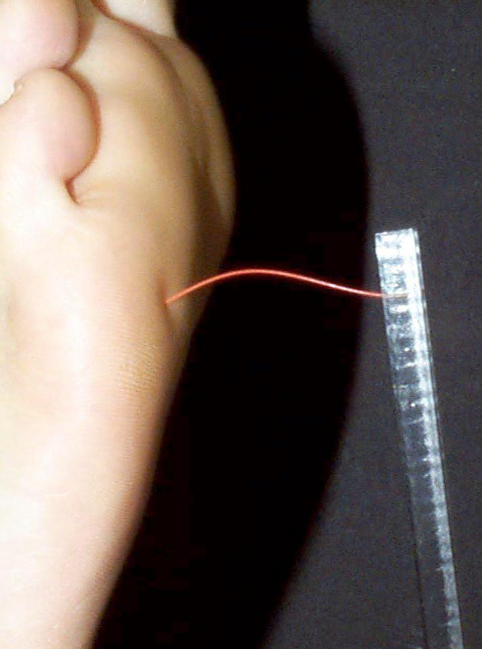
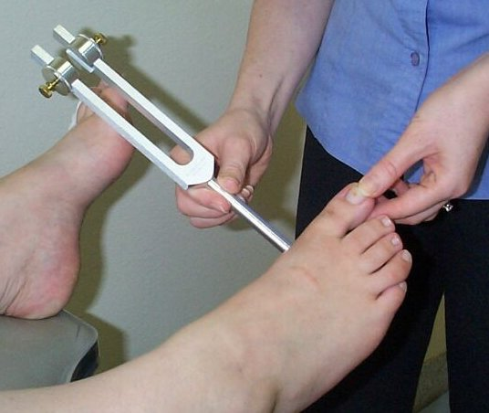
Skrining Neuropati Diabetes
Monofilament test dan persepsi getar garpu tala

Slide 52
Perawatan Kaki di Rumah
Patient should
check feet daily
Wash feet daily
Keep toenails short
Protect feet
Always wear shoes
Look inside shoes before putting them on
Always wear socks
Break in new shoes gradually

Slide 53
Summary
Diabetes is a chronic illnes that requires continuing medical care and support to prevent acute complication and to reduce the risk of long-term complication.
The common condition coexisting with type 2 diabetes (eg. Hypertension and dyslipidemia) are clear risk factor for CVD, and diabetes itself confers independent risk.

Slide 54
The greater benefits (clinical and economical) of glycemic control are obtained when simultaneous control of glycemia, BP, and lipid levels has been achieved.
Target recommendation for adults with diabetes (ADA 2011) :
A1C < 7.0%
Blood pressure < 130/80 mmHg
Lipids
LDL cholesterol < 100 mg/dl

Slide 55
Thank You

