Slide 1
Overview Diabetes Mellitus

Slide 2
Standar Kompetensi Dokter (2006)

Slide 5
Moduls consist of :
Definition, presentation, diagnosis, classification
Aetiopathology
Management : Lifestyle modification
(Basic carbohydrate counting)
Management : Drug therapy
Complication (acute & chronic)
Prevention
Children and Pregnancy

Slide 6
DIABETES MELLITUS Definition, Presentation, Diagnosis, and Classification
Laksmi Sasiarini
Divisi Endokrin – Metabolik
FK UB – RSU dr. Saiful Anwar
Malang
2011

Slide 7
Diabetes Mellitus
A metabolic disorder of multiple aetiology characterized by chronic hyperglycaemia with disturbances of carbohydrate, fat and protein metabolism resulting from defects in insulin secretion, insulin action or both
Associated with a risk of developing late diabetic complications including
Microvascular (retinopathy, nephropathy)
Macrovascular (atherosclerosis)
Neuropathy

Slide 8
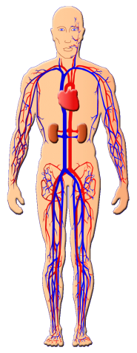
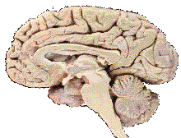
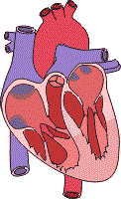
Diabetes : A malignant vascular disorder
the most frequent cause of new cases of blindness among adults aged
20 to 74.
Stroke
2-4 x risk for stroke and coronary heart disease *)
Diabetic Retinopathy
Cardiovascular disease
Diabetic Nephropathy
Myocardiac infarct
*) Most common cause of death in diabetics
Accounts for ~40% of all new cases of
end-stage renal disease (ESRD).
Diabetic Neuropathy
Most common cause of renal failure → Dialysis
Most common cause of
lower limb amputation
National Diabetes Information Clearinghouse. Diabetes Statistics–Complications of Diabetes. http://www.niddk.nih.gov/health/diabetes/pubs/dmstats/dmstats.htm#comp.
Notes:
Diabetes mellitus is associated with a wide variety of microvascular and macrovascular complications.

Slide 9
GLYCEMIC GOALS IN ADULT
 | IDF | AACE | ADA
HbA1C (%) | < 6.5 | ≤ 6.5 | < 7.0
Fasting/preprandial glucose (mmol/L / mg/dL) | < 6.0 / < 110 | < 6.0 / < 110 | 3.9-7.2 / 70-130
2-h postprandial glucose (mmol/L / mg/dL) | < 7.8 / < 140 | < 7.8 / < 140 | < 10.0 / < 180*
ADA recommends that postprandial glucose measurements should be made 1- 2h after the beginning of the meal
IDF : International Diabetes Federation
AACE : American Association of Clinical Endocrinologist

Slide 10
NHANES reveals the under-management of diabetes
NHANES 1999 – 2000 → 441 (6%) had previously diabetes
Mean HbA_{1c} value was 7.8%
37% had an HbA_{1c} value <7.0%
26% had an HbA_{1c} value of 7.0–8.0%
37% had an HbA_{1c} value >8.0%
54% → Oral Hypoglycemic Agents
27% → insulin therapy with or without OHAs
19% → without any kind of drugs
Saydah S, et al. JAMA 2004;291:335–42.
Notes:
Of the 4,874 adults who completed the 1999–2000 National Health and Nutrition Examination Survey (NHANES) in the USA, 441 (6%) had previously diagnosed diabetes.
The mean HbA_{1c} value in the subgroup with diabetes was 7.8%. Only 37% of these individuals had an HbA_{1c} value <7.0%, and a further 26% had an HbA_{1c} value of 7.0–8.0%.
OHAs alone were the most common diabetes treatment (54%). Insulin therapy with or without OHAs was used by 10% and 17% of the survey’s diabetes population, respectively. The remaining 19% of individuals received neither insulin nor OHAs.
NHANES highlights the under-management of diabetes. Almost two-thirds of the individuals with diabetes had poor glycaemic control, and yet insulin therapy is underutilised.
Saydah S, et al. JAMA 2004;291:335–42.

Slide 11
The implementation of the standards of care for diabetes has been supoptimal in most clinical settings.
A recent report (Cheung et al, 2009) indicated that only
57.1% of adults with diabetes achieved an A1C of 7%, 45.5% had a blood pressure 130/80 mmHg,
46.5% had a total cholesterol 200 mg/dl.
Only 12.2% of people with diabetes achieved all three treatment goals.

Slide 12
Persentase kadar glukosa darah responden DDM* setelah 2 jam pemberian diet cair 300 kalori
JENIS KELAMIN | KADAR GLUKOSA DARAH
 | < 140 | 140 - < 200 | ≥ 200
Laki-laki | 33,1 | 17,8 | 49,1
Perempuan | 17,3 | 15,9 | 66,8
*DDM : Diagnosed DM

Slide 13
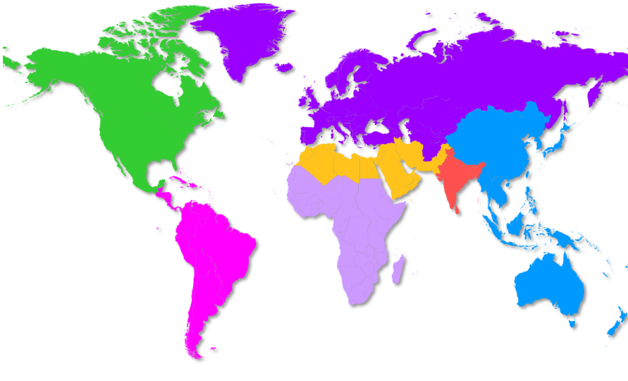
Diabetes is an increasing healthcare epidemic throughout the world
IDF Regions and global projections for the number of people with diabetes (20-79 years), 2010-2030
55.2
66.2
+20%
37.4
53.2
+42%
Africa
Middle East and North Africa
76.7
112.8
+47%
Europe
26.5
51.7
+94%
North America
South and Central America
58.7
101.0
+72%
South-East Asia
12.1
23.9
+98%
Western Pacific
16.0
29.6
+65%
Worldwide:
284.6 million people in 2010
438.4 million projected for 2030
54% increase
IDF. Diabetes Atlas 4th Edition – 2009
Notes:
The IDF found that, as a global phenomenon, the prevalence of diabetes is predicted to increase from 246 million in 2007 to 380 million by 2025, an increase of 55%.¹ T2DM alone has reached epidemic proportions and affects approximately 5.9% of adults worldwide. The prevalence is increasing steadily and is expected to affect 7.1% of adults by the year 2025. In particular, the increase in T2DM is seen among younger people and in developing countries. Indeed, a disproportionate number of diabetic patients live in the Asia-Pacific region; approximately 81 million people with diabetes live in India and China compared with 19 million in the USA.¹
In summary, these data provide an updated quantification of the current and growing public health burden of diabetes across the world. The human and economic costs of this epidemic have severe implications for healthcare resource use.
Reference
International Diabetes Federation. Diabetes Atlas 3rd Edition (2006): Page 5

Slide 14
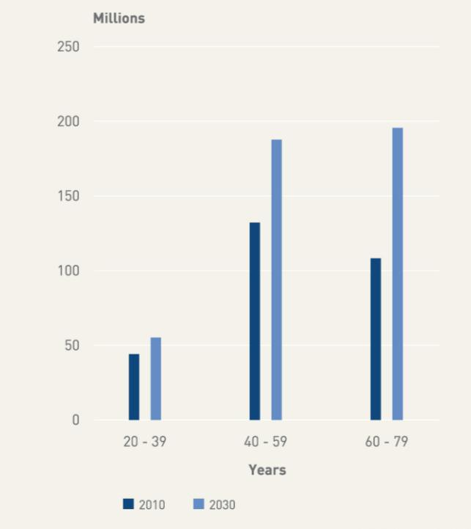
Number of people with diabetes by age group,
2010 and 2030
IDF Diabetes Atlas, 4th ed. 2009

Slide 15
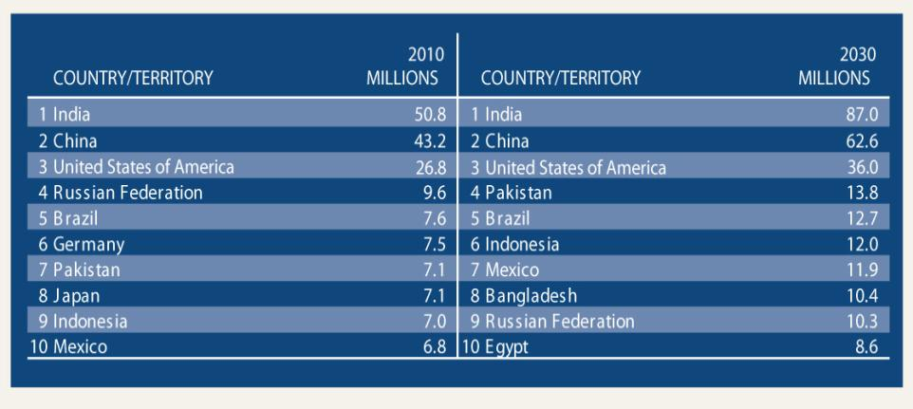
Top 10
Number of people with diabetes
(20-79 years), 2010 and 2030
IDF Diabetes Atlas, 4th ed. 2009

Slide 16
Data Riskesdas tahun 2007
Pengambilan darah vena untuk pemeriksaan glukosa darah dilakukan pada responden usia >15 tahun yang tinggal di daerah perkotaan (24,417 responden).
Responden dipersiapkan puasa 10-14 jam sebelum diambil darah, kemudian dilakukan TTGO, kecuali bagi pasien DM diberikan diet cair 300 kalori.
Kriteria diagnosis DM dibuat berdasarkan WHO 1999 dan ADA 2003, di mana 2 jam setelah pembebanan glukosa didapatkan hasil GD :
< 140 mg/dl Tidak DM
140 - < 200 mg/dl Toleransi Glukosa Terganggu (TGT)
≥ 200 mg/dl DM

Slide 17
 | TGT | DDM* | UDDM** | Total DM***
Penduduk perkotaan usia > 15 thn di Indonesia | 10,2 | 1,5 | 4,2 | 5,7
*DDM : Diagnosed DM
**UDDM : Undiagnosed DM
***Total DM : DDM + UDDM

Slide 18
Prediabetes
Indonesian basic health research (Riskesdas)
Diagnosed DM = 1,5%
Undiagnosed DM = 4,2%
Total DM = 5,7%
IGT = 10,2 %
People who know they have diabetes
People who don’t know they have diabetes

Slide 19
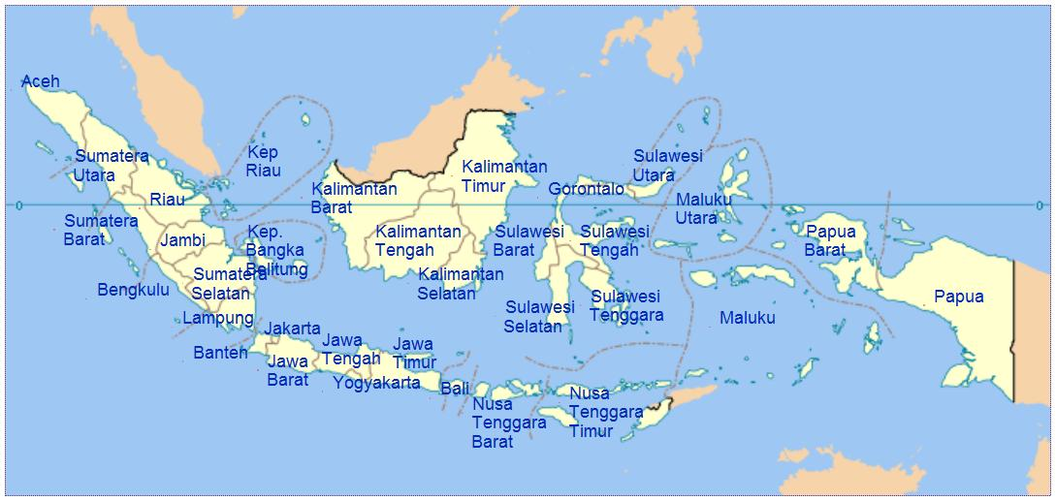
Prevalensi DM
4
3
1
2
Jawa Timur 6,8%
Tertinggi :
Kalimantan Barat 11,1%
Maluku 11,1%
Riau 10,4%
NAD 8,5%
Terendah :
Papua 1,7%
NTT 1,8%

Slide 20
INSULIN &
HOMEOSTASIS GLUKOSA

Slide 21
PANKREAS

Slide 22
Insulin
production and action

Slide 24
Model of underlying factors in type 2 diabetes: β-cell dysfunction and insulin resistance
Diabetes genes Adipokines Inflammation Hyperglycaemia Free fatty acids Other factors
β-CELL DYSFUNCTION
➲ Insulin secretion
INSULIN RESISTANCE
 Lipolysis
 Glucose production
➲ Glucose uptake
 Free fatty acids
 Blood glucose
Adapted from Stumvoll M et al. Lancet 2005; 365:1333–1346.

Slide 25
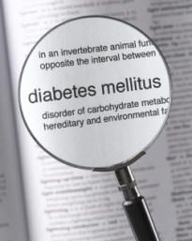
Siapa saja yang bisa terkena DM ?
1. Usia ≥ 45 tahun
2. Usia < 45 tahun, terutama dengan kegemukan, yang disertai dengan faktor resiko :
• kebiasaan tidak aktif
• turunan pertama dari orang tua dengan DM
• riwayat melahirkan bayi dengan BB lahir bayi > 4000 gram, atau riwayat DM gestasional
• hipertensi (≥ 140/90 mmHg)
• kolesterol HDL ≤ 35 mg/dL dan atau trigliserida ≥ 250 mg/dL
• menderita polycystic ovarial syndrome (PCOs) atau keadaan lain yang terkait dengan resistensi insulin
• adanya riwayat toleransi glukosa terganggu (TGT) atau glukosa darah puasa terganggu (GDPT) sebelumnya → Prediabetes
• memiliki riwayat penyakit jantung

Slide 26
NORMAL
PREDIABETES
DIABETES
Puasa : <100 mg/dl
IFG : 100-125 mg/dl
>126 mg/dl
2 jam PP: <140 mg/dl
IGT : 140-199 mg/dl
>200 mg/dl
FPG : Fasting plasma glucose (Gula darah puasa)
2-h PG : 2-hour plasma glucose (Gula darah 2 jam setelah makan)
IFG : Impaired fasting glucose (Gula darah puasa terganggu)
IGT : Impaired glucose tolerance (Toleransi glukosa terganggu)

Slide 27
Prevalensi TGT
3
2
1
Jawa Timur 11,6%
Jawa Timur 6,8%
Tertinggi :
Papua Barat 21,8%
Sulawesi Barat 17,6%
Sulawesi Utara 17,3%
Terendah :
Jambi 4,0%
NTT 4,9%

Slide 28
Prevalensi TGT dan DM menurut IMT, obesitas abdominal, dan hipertensi
Karakteristik responden | TGT | DM
IMT : kurus | 10,3 | 3,7
normal | 9,1 | 4,4
BB lebih | 12,3 | 7,3
obesitas | 16,3 | 9,1
Perut : obesitas sentral (+) | 15,9 | 9,7
obesitas sentral (-) | 9,1 | 4,0
Hipertensi : (+) | 15,1 | 9,0
(-) | 8,4 | 3,4
*IMT : Indeks Massa Tubuh

Slide 30
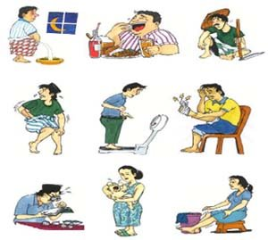
Bagaimana diagnosis DM ditegakkan ?
1. | Gejala klasik DM + GDA ≥ 200 mg/dL atau
2. | Gejala klasik DM + GDP ≥ 126 mg/dL dengan puasa 8 jam atau
3. | 2 jam PP TTGO ≥ 200 mg/dL TTGO dengan beban 75 g glukosa
Keluhan klasik DM : rasa haus yang berlebihan, sering kencing terutama malam hari dan berat badan menurun dengan cepat.
Keluhan lain dapat berupa lemah badan, kesemutan, gatal, mata kabur, gairah seks menurun, luka sukar sembuh.

Slide 31
Relation of FPG, 2hrPG, A1C to Retinopathy : Pima Indians
15
FPG
2hPG
A1C
10
Retinopathy (%)
5
0
FPG (mg/dL)
2hPG (mg/dL)
A1C (%)
70-
38-
3.4-
89-
94-
4.8-
93-
106-
5.0-
97-
116-
5.2-
100-
126-
5.3-
105-
138-
5.5-
109-
156-
5.7-
116-
185-
6.0-
136-
244-
6.7-
226-
364-
9.5-
ADA Expert Committee. Diabetes Care 2003;26(S1):S5-S20.
Notes:
Key Points
The relationships between FPG, 2hPG and the development of retinopathy were evaluated in Pima Indians over a wide range of plasma glucose cut-points. Both variables were associated with retinopathy, indicating that both could work as diagnostic measures for diabetes. McCance et al, the authors, concluded that both of these measurements were equal relative to the properties used previously to determine diagnostic criteria.
Report of the Expert Committee on the Diagnosis and Classification of Diabetes Mellitus. Diabetes Care 2003;26 (S1):S5-S20.

Slide 32
Relation of FPG, 2hPG, A1C to Retinopathy : NHANES III
15
FPG
2hPG
A1C
10
Retinopathy (%)
5
0
FPG (mg/dL)
2hPG (mg/dL)
A1C (%)
42-
34-
3.3-
87-
75-
4.9-
90-
86-
5.1-
93-
94-
5.2-
96-
102-
5.4-
98-
112-
5.5-
101-
120-
5.6-
104-
133-
5.7-
109-
154-
5.9-
120-
195-
6.2-
ADA Expert Committee. Diabetes Care 2003;26(S1):S5-S20.
Notes:
Key Points
NHANES III looked at 2821 subjects aged 40 to 74 years who had an OGTT, A1C measurement, and retinopathy assessment by means of fundus photography. While all measures were associated with retinopathy, the strongest was for 2hPG.
Report of the Expert Committee on the Diagnosis and Classification of Diabetes Mellitus. Diabetes Care 2003;26 (S1):S5-S20.

Slide 33
Relation of FPG, 2hPG, A1C to Retinopathy : Egypt
50
FPG
2hPG
A1C
40
30
Retinopathy (%)
20
10
0
FPG (mg/dL)
2hPG (mg/dL)
A1C (%)
57-
39-
2.2-
79-
80-
4.7-
84-
90-
4.9-
89-
99-
5.1-
93-
110-
5.4-
99-
125-
5.6-
108-
155-
6.0-
130-
218-
6.9-
178-
304-
8.5-
258-
386-
10.3-
ADA Expert Committee. Diabetes Care 2003;26(S1):S5-S20.
Notes:
Key Points
Similar findings were confirmed as a result of a study done in Egypt, which showed that the FPG and 2hPG were strongly and equally associated with retinopathy. For both measures, retinopathy prevalence was significantly higher at the point at which the two components of the bimodal frequency distribution intersected.
Report of the Expert Committee on the Diagnosis and Classification of Diabetes Mellitus. Diabetes Care 2003;26 (S1):S5-S20.

Slide 34
Type 2 Diabetes: Progression from Underlying Defects
Insulin Insulin Macrovascular Sensitivity Secretion Diseases
30% 50% 50%
50% 70%-100% 40%
70% 150% 10%
100% 100%
Type 2 Diabetes
IGT
Impaired Glucose Metabolism
Normal Glucose Metabolism
Adapted from Groop.Diabetes Obesity Metab 1999;1(Suppl.1):S1-S7.
Notes:
This figure shows that the underlying problems associated with diabetes are present long before a diagnosis of diabetes can be made by today’s standards.
As insulin sensitivity decreases, insulin production increases up to a point where the pancreas can no longer sustain these secretion levels. By the time of overt diabetes, the pancreas’ ability to produce insulin is already severely impaired by years of overproduction.
Additionally, macrovascular disease begins early and 50 per cent of patients with type 2 diabetes have evidence of macrovascular disease.

Slide 35
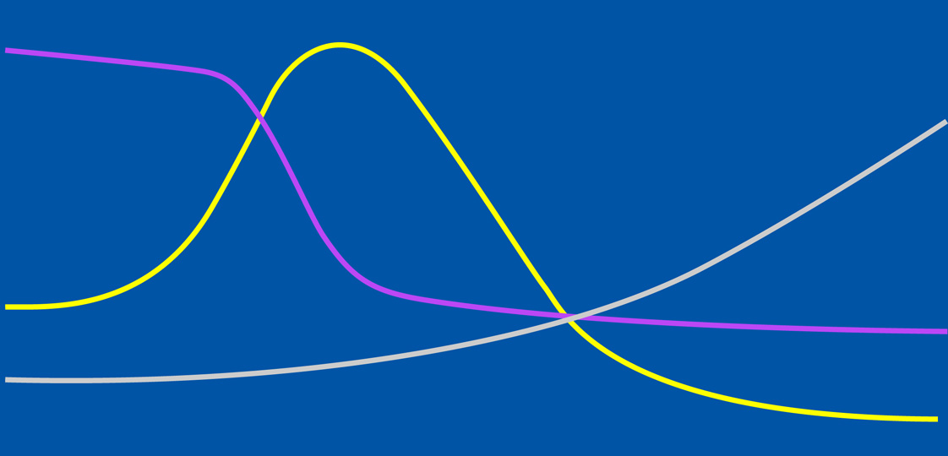
The progressive nature of type 2 diabetes
Normal
Impaired glucose tolerance
Type 2 diabetes
Late type 2 diabetes complications
Insulin sensitive
Hyperglycaemia
Normal insulin secretion
Insulin resistance
Normoglycaemia
β-cell exhaustion
Insulin resistance
Fasting plasma glucose Insulin sensitivity Insulin secretion
Adapted from Bailey CJ et al. Int J Clin Pract 2004; 58:867–876. Groop LC. Diabetes Obes Metab 1999; 1 (Suppl. 1):S1–S7.

Slide 36
KLASIFIKASI DM
Tipe 1 | Destruksi sel beta, umumnya menjurus ke defisiensi insulin absolut Autoimun Idiopatik
Tipe 2 | Bervariasi mulai yang terutama dominan resistensi insulin disertai defisiensi insulin relatif sampai yang terutama defek sekresi insulin disertai resistensi insulin
Tipe lain | Defek genetik fungsi sel beta Defek genetik kerja insulin Penyakit eksokrin pankreas Endokrinopati Karena obat atau zat kimia Infeksi Sebab imunologi yang jarang Sindrom genetik lain yang berkaitan dengan DM
Diabetes mellitus gestasional

Slide 37
GLYCEMIC GOALS IN ADULT
 | IDF | AACE | ADA
HbA1C (%) | < 6.5 | ≤ 6.5 | < 7.0
Fasting/preprandial glucose (mmol/L / mg/dL) | < 6.0 / < 110 | < 6.0 / < 110 | 3.9-7.2 / 70-130
2-h postprandial glucose (mmol/L / mg/dL) | < 7.8 / < 140 | < 7.8 / < 140 | < 10.0 / < 180*
ADA recommends that postprandial glucose measurements should be made 1- 2h after the beginning of the meal
IDF : International Diabetes Federation
AACE : American Association of Clinical Endocrinologist

Slide 38
The New Paradigm of (Type 2) Diabetes Treatment
Treatment – Driven by Target (A1C<7%)
Early Combinations (including with insulin)
Aggressive Insulin Treatment

Slide 39
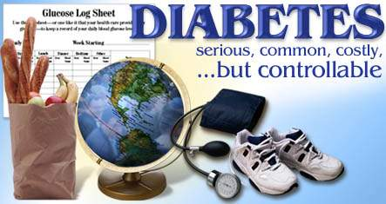

Slide 40
Thank You

