Slide 1
Obat Hiperlipoproteinemia
FISIOLOGI TRANSPORT LIPOPROTEIN
LIPOPROTEIN : VLDL, IDL, LDL, HDL, Lp(a),
KILOMIKRON dan KILOMIKRON REMNAN
BERPERAN DALAM TRANSPORT LIPID YANG DISINTESA ENDOGEN (endogenous pathway) DAN LIPID YANG BERASAL DARI LUAR (DIET)(exogenous pathway)
Klasifikasi berdasar kandungan apolipoprotein→
Apolipoprotein B (apo B100) mengandung VLDL, IDL, LDL, transport lipid endogen dari hepar ke jar. nonhepatik. Kilomikron, transport lipid diet dari usus ke jar perifer dan hati. Apo A-I mengandung HDL, membantu transport lipid antara lipoprotein dan mengangkut kolesterol dari jar perifer kembali ke hepar

Slide 2
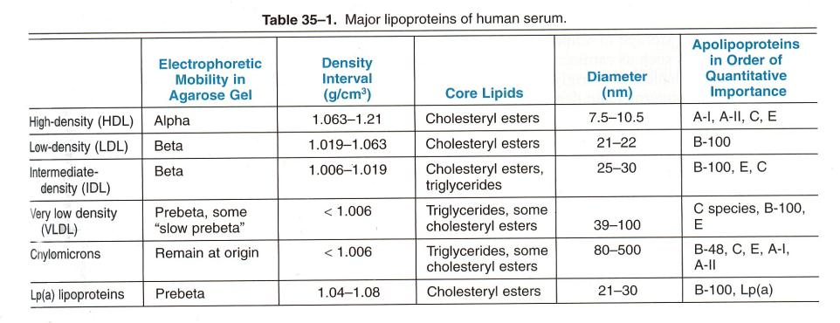

Slide 3
Sumber lipid : Diet dan sintesis di hati
Trigiserida(TG) dan Kolesterol (K) sukar larut dalam, air untuk transportasinya butuh bantuan protein spesifik ( apoprotein dan fosfolipid) komplek lipoprotein
Bila makanan mengandung K berlebih , hati akan mensintesis TG dalam jar lemak dan mendistribusikan melalui VLDL ke jar lemak.
Sumber K endogen yang utama adalah hati . Hati mensintesis K dari as acetat dg bantuan Enz HMG Co A Reduktase
Sintese K oleh hati dikontrol oleh K darah . Bila kadar K plasma meningkat aktivitas HMG CoA reductase sintesa K turun

Slide 4
Classification of Plasma Lipid Levels*
Total Cholesterol
<200 mg/dl Desirable
200-239 mg/dl Borderline high
≥ 240 mg/dl High
HDL-C
<40 mg/dl Low ( consider 50 mg/dl for women)
>60 mg/dl High
LDL-C
<100 mg/dl Optimal
100-129 mg/dl Near optimal
130-159 mg/dl Borderline high
160-189 mg/dl High
≥ 190 mg/dl Very high
"Triglycerides
<150 mg/dl Normal
150-199 mg/dl Borderline high
200-499 mg/dl High
≥ 500 mg/dl Very high

Slide 5
Lipid darah jalur eksogen :
TG & K yg berasal dari makanan dlm usus dikemas sbg kilomikron dalam jar lemak hidrolisis o/ lip lipase free fatty acid & kilomikron remnant (Kil yg dihilangkan sebagian besar TG [ K > TG ])
Diangkut dlm sal limpe via ductus torasikus As lemak bebas akan menembus endotel masuk ke dalam jar lemak / sel otot menjadi TG( cadangan ) atau dioksidasi (energi )

Slide 6
Exogenous Pathway
Food particles
Liver
Bile Acids
Intestines
Chylomicrons
Chylomicron Remnants
Bloodstream
Breakdown of Triglyceride
Free Fatty Acids

Slide 7
Lipid darah jalur endogen :
TG & Kolesterol Ester yg disintesis o/ hati diangkut scr endogen dlm bentuk VLDL,IDL & LDL( Lip yg mengand K plg banyak 60 – 70 %)
LDL Mengalami katabolisme mel jalur reseptor dan non reseptor Jalur katabolisme reseptor dapt ditekan o/ prod K endogen .
Bila katabolisme LDL oleh sel hati dan jar perifer berkurang K plasma meningkat ( peningkatan tersebut sebagian akan di salurkan ke dalam makrofag yg akan membentuk sel busa / foam sel) yg berperan pada terjadinya aterosklerosis .

Slide 8
Foam Cell Formation
LDL
Oxidized LDL
Macrophage
+
Oxidative Stress
Foam Cell

Slide 9
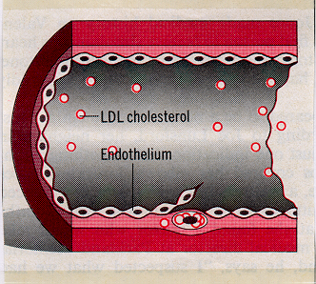
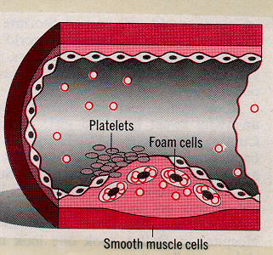
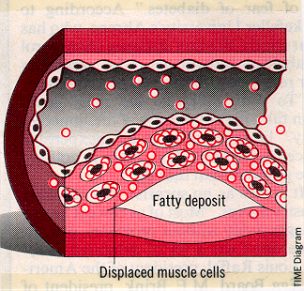

Slide 10
Endogenous Pathway
LDL
HDL
Liver
Body Tissues
Bloodstream
IDL
VLDL
Breakdown of Triglyceride
Free Fatty Acids

Slide 11
METABOLISME LIPOPROTEIN DI HEPAR

Slide 12
LIPOPROTEIN DISORDER
DETEKSI → PENGUKURAN KANDUNGAN LIPID SERUM SESUDAH 10 JAM PUASA
RISIKO ATHEROSCLEROTIC HEART DISEASE DENGAN PE ATHEROGENIC LIPOPROTEIN, BERHUBUNGAN TERBALIK DG HDL
IDEAL TG < 150 MG/DL
NATIONAL CHOLESTEROL EDUCATION PROGRAM
ADULT TREATMENT GUIDELINES
 | Total cholesterol (mg/dl) | LDL cholesterol (mg/dl)
Desirable Borderline to high¹) High | <200 200-239 ≥240 | <130 130-159 ≥160
¹) Consider as high if coronary heart disease or more than two risk factor present. A level of HDL cholesterol below 35mg/dl is considered a major risk factor. The major cholesterol goal in patient with coronary artery disease is 100mg/dl or less

Slide 13
THE PRIMARY HYPERLIPOPROTEINEMIAS AND THEIR DRUG TREATMENT
DISORDER | MANIFESTATION | SINGLE DRUG*) | DRUG COMBINATION
Primary chilomicronemia | Chylomicron, VLDL increased | Dietary management | Niacin plus fibrate
Familial hypertriglycerid emia (severe) | VLDL, chylomicron increased | Niacin, fibrate | Niacin plus fibrate
Familial hypertriglycerid emia (Moderate) | VLDL increased; chylo micron maybe increased | Niacin, fibrate
Familial combined hyper lipoproteinemia | VLDL increased LDL increased VLDL, LDL increased | Niacin, fibrate Niacin,,reductase inhibitor resin Niacin, reductase inhibitor | Niacin plus resin or reductase inhibitor Niacin plus resin or reductase inhibitor
Familial hypercholesterol emia, heterozygous | LDL increased | Resin, reductase inhibitor, niacin | Two or three of the individual drugs
Familial hypercholesterol emia, homozygous | LDL increased | Niacin, atorvastatin | Resin plus niacin plus reductase inhibitor
Lp(a) hyperlipoprotein emia | Lp(a) increased | Niacin

Slide 14
Secondary causes of hyperlipoproteinemia
Hypertriglyceridemia | Hypercholesterolemia
Diabetes mellitus Alcohol ingestion Severe nephrosis Estrogens Uremia Corticosteroid excess Hypothyroidism Gycogen strorage disease Hypopituitrarism Acromegaly Immunoglobulinplipoprotein complex disorders Lipodystrophy | Hypothyroidism Early nephrosis Resolving lipemia Immunoglobulinplipoprotein complex disorders Anorexia nervosa Cholestasis Hypopitoitarism Corticosteroid excess

Slide 15
MANAGEMENT HYPERLIPOPROTEINEMIA
DIETARY MANAGEMENT
-diet kolesterol dan lemak jenuh dikurangi
-diet + obat
DRUGS USED IN HYPERLIPIDEMIA

Slide 16
Cholesterol-Lowering Drug Therapy
HMG CoA Reductase Inhibitors (statin)
Lovastatin
Pravastatin
Simvastatin
Fluvastatin
Atorvastatin
Rosuvastatin
Fibric acid derivatives (Fibrates)
Gemfibrozil
Fenofibrate
Bile Acid Binding Resins
Cholestyramine
Colestipol
Niacin (nicotinic acid)

Slide 17
hepatosit
Blood
Gut
Acetyl –CoA
HMG-CoA
HMG-CoA
reductase
inhibitor
Cholesterol
Bile acid
LDL
R
VLDL
Niacin
Resin
Tempat kerja HMG-CoA reductase inhibitor, niacin dan resin untuk terapi hiperlipiemia. Reseptor LDL meningkat dg terapi resin dan HMG-CoA reductase inhibitor

Slide 18
HMG CoA Reductase Inhibitors
2.) Synthesis
1.) LDL Uptake
HMG CoA
HMG CoA
Cholesterol
Cholesterol
Bile Acids
Bile Acids

Slide 19
Statin Adverse Effects
Major toxicities:
↑ Hepatic transaminases
Myalgia
Rhabdomyolysis
Selected minor adverse effects:
Dyspepsia/heartburn
Headache
Taste disturbances

Slide 20
Monitoring of Lipid Lowering Therapy
Lipid Profiles
Before initiation and at 6-12 weeks until stable
Every 6 months thereafter
Hepatic Transaminases
Baseline and every 6-12 weeks until stable
Every 6 months thereafter
Glucose, Uric Acid

Slide 21
How do you Choose a Statin? Differences among the HMG-CoA Reductase Inhibitors
Potency (LDL, HDL, TG)
Clinical efficacy
Hydrophilic vs Lipophilic
Pharmacokinetics
Cost
Drug Interactions
Non-lipid effects

Slide 22
Bile Acid Binding Resins
2.) Synthesis
1.) LDL Uptake
HMG CoA
HMG CoA
Cholesterol
Cholesterol
Bile Acids
Bile Acids
Intestines
Intestines

Slide 23
Precautions
Efek yang tidak diinginkan
Konstipasi , nyeri abdomen, rasa tak enak (unpleasant taste)

Slide 24
Niacin (Nikotinic acid )
Mechanism of action
Menghambat pembentukan free fatty acid dari adipose tissue
Menghambat sintesis VLDL and LDL
Effects on lipids
↓↓↓ LDL, ↑↑ HDL, ↓↓↓ TG
Lowers Lp(a)

Slide 25
Niacin – farmakokinetik
Diberikan p.o yang akan diubah menjadi nikotinamid yg merupakan co faktor dari NAD (nikotinikk adenin dinukleotida )
S.E :
Kemerahan pada kulit disertai perasaan panas
Pruritus . Gastrointestinal, hyperuresemia , gangguan toleransi Glucosa dan hepatotoksisitas

Slide 26
Niacin - Precautions
Drug interactions
Alcohol: ↑ risk of hepatotoxicity
Statins, fibrates: ↑ risk of hepatotoxicity and/or myalgias

Slide 27
Fibrates
Mechanism of action
Inhibition of cholesterol synthesis
Decreased TG synthesis
Inhibition of lipolysis in adipose tissue
Decreased production of VLDL/↑ clearance
Increased plasma and hepatic LPL( lipoprotein lipase ) activity
Effect on lipids
↓ LDL, ↑↑ HDL, ↓↓↓ TG

Slide 28
Farmakokinetik :
Peroral absorbsi sempurna
Mengalami estrifikasi menjadi as klofibrat aktif yg terikat pada albumin.
Diekskersi ke dalam urin dalam bentuk glukoronida.

Slide 29
Fibrates Precautions
Adverse effects
Nausea, diarrhea, cholelithiasis, phototoxicity
Drug interactions
Increased risk of hepatotoxicity and/or myalgias pada penggunaan bersamaan dengan statins and/or niacin
Protein binding displacement (e.g., warfarin)
Kontra indikasi :
Kelainan fgs hati, ginjal dan wanita hamil

Slide 30
Inhibitors of intestinal sterol absorption
Exp : Ezetimibe
-Inhibit intestinal absorption of : phytosterol
cholesterol
-Reduction -LDL
Farmakokinetik :
peak level 12-14 jam
half life 22 jam → mengalami enterohepatic cycle
ekskresi 80 % melalui feses
Therapeutic uses : LDL 18 % pada primary hypercholes terolemia
HDL meningkat minimal

Slide 31
The End

