Slide 1
Thyroid storm

Slide 2
Epidemiology
The incidence of thyroid storm :
less than 10% of patients hospitalized for thyrotoxicosis
The mortality rate : 20-30%

Slide 3
Etiology
Graves’ disease (most common)
Solitary toxic adenoma or toxic multinodular goiter
Rare cause
hypersecretory thyroid carcinoma
thyrotropin-secreting pituitary adenoma
struma ovarii/teratoma
human chorionic gonadotropia–secreting hydatidiform mole.
Other causes
interferon alpha
interleukin-2–induced thyrotoxicosis

Slide 4
Precipitating event
Systemic insults
(Thyroid) surgery, trauma, myocardial infarction, pulmonary thromboembolism, diabetic ketoacidosis, parturition, or severe infection
Discontinuation of antithyroid drugs
Excessive ingestion or intravenous administration of iodine (eg, radiocontrast dyes, amiodarone)
Radioiodine therapy
Pseudoephedrine and salicylate use

Slide 5
Pathogenesis theory
Free T4 ↑, but similar total T4
↑ target cell beta-adrenergic receptor density
Postreceptor modifications in signaling pathways

Slide 6
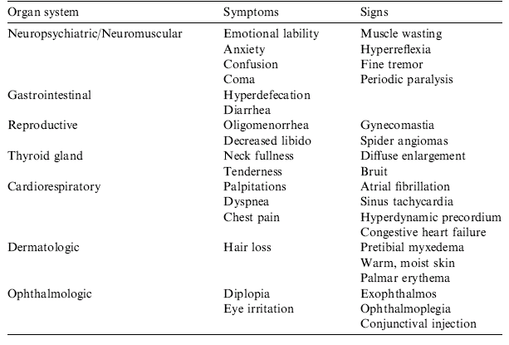
Clinical presentation

Slide 7
diagnosis

Slide 8
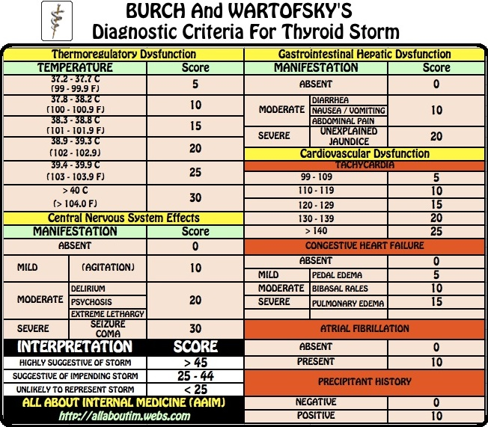

Slide 9
Laboratory Result
↑ free T4 and free T3
↓TSH
T3/ T4 ratio
> 20: Graves’ disease and toxic nodular goiter
< 15: thyroiditis, iodine exposure
Hyperglycemia, hypercalcemia, elevated alkaline phosphatase, leukocytosis, and elevated liver enzymes
Cortisol ↑ (normal level → adrenal insufficiency)

Slide 10
Electrocardiogram
Sinus tachycardia (40 %)
Atrial fibrillation (10-20 %)
> 60 y/o,
Underlying structural heart disease

Slide 11
Management

Slide 12
Multiple targets
Stopping synthesis of new hormone within the thyroid gland
Halting the release of stored thyroid hormone from the thyroid gland
Preventing conversion of T4 to T3
Controlling the adrenergic symptoms
Controlling systemic decompensation with supportive therapy

Slide 13
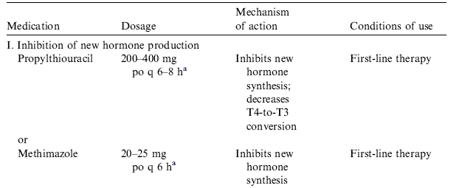
Thionamide

Slide 14
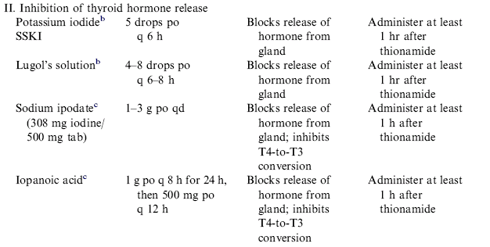
Iodine therapy
‘‘Wolff-Chaikoff’’ effect

Slide 15
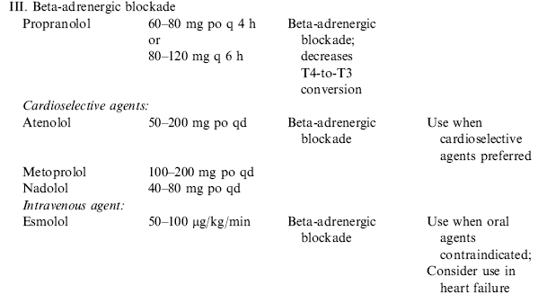
Beta-blockade

Slide 16
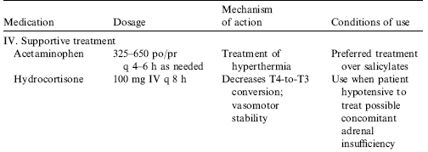

Slide 17
Supportive care
Antipyretics (acetaminophen)
Salycilates : ↓ thyroid protein binding → ↑ free thyroid hormone levels.
External cooling measures
Intravenous fluids with dextrose
Multivitamins
Antibiotics
Treating the precipitating cause !!!

Slide 18
Summary
Thyrotoxicosis and thyroid storm pose a critical diagnostic and therapeutic challenge to the clinician.
Recognition of life-threatening thyrotoxicosis and propmpt use of the arsenal of medication aimed at halting the thyrotoxicosis process at every level is essensial to successful management.

Slide 19
Thank You

